Slide 1
Learning Objective
I will be able to sketch cubic polynomials
Success Criteria
At the end of the lesson, I will be able to:
Determine number of roots a cubic polynomial has
Determine nature of cubic graphs
Sketch cubic graphs

Slide 2
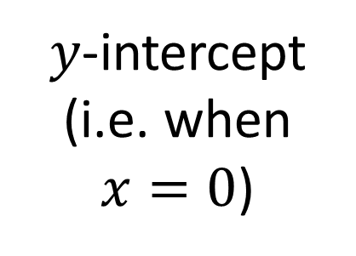
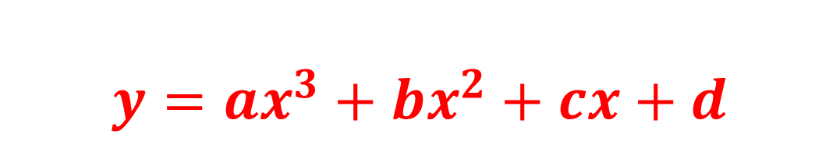
General form of a cubic
Concept Development
$$y={ax}^{3}+bx^{2}+cx+d$$
Leading coefficient
$y$-intercept (i.e. when $x=0$)

Slide 3

Concept Development
$$y={ax}^{3}+bx^{2}+cx+d$$
The graph of a cubic function will have:
One y-intercept
One, Two or Three x-intercepts
A point of Inflection

Slide 4
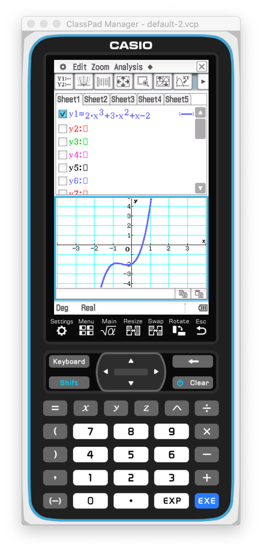
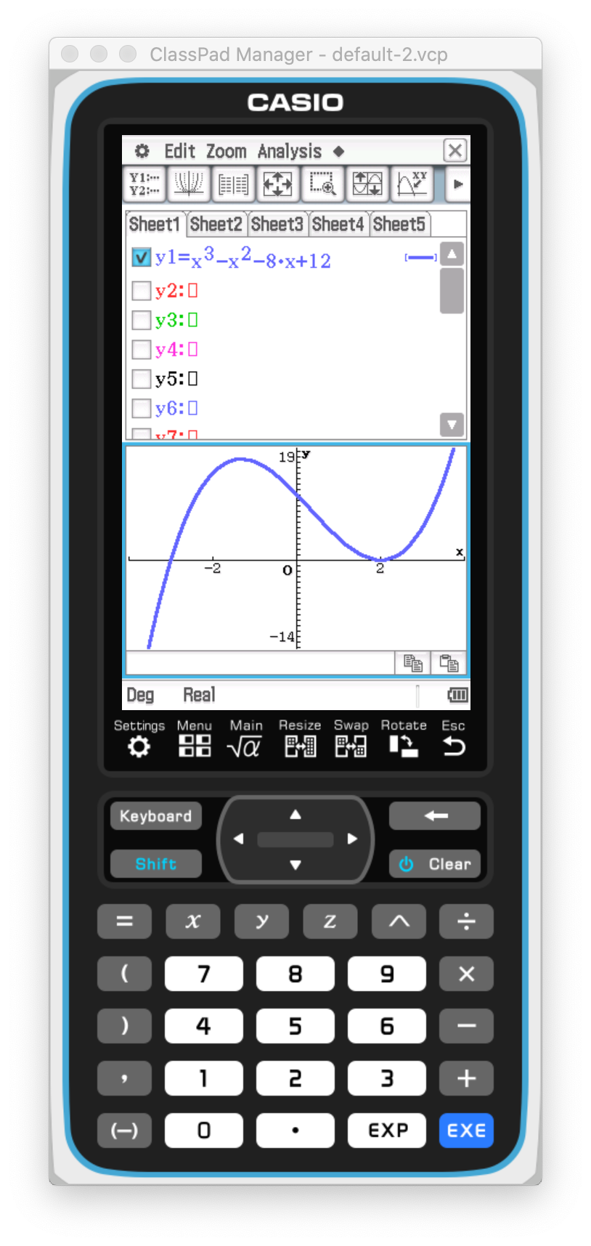
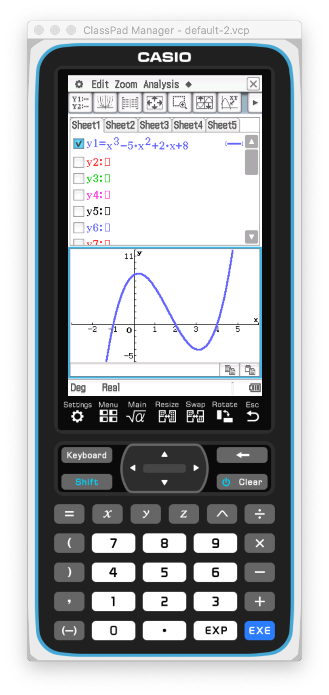
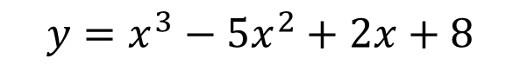
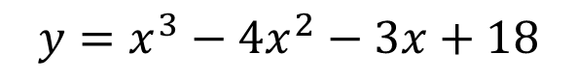
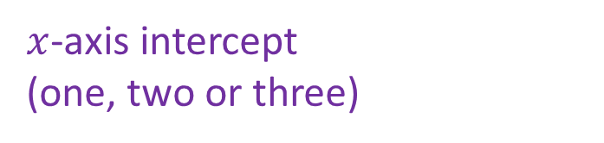
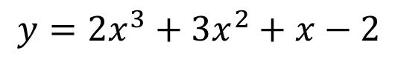
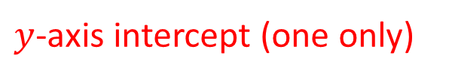
Concept Development
$$y=2x^{3}+3x^{2}+x−2$$
$$y=x^{3}−4x^{2}−3x+18$$
$$y=x^{3}−5x^{2}+2x+8$$
$y$-axis intercept (one only)
$x$-axis intercept
(one, two or three)

Slide 5
Point of inflection – the point where the curve change from being concave down to concave up, or from concave up to concave down
Concept Development

Slide 6
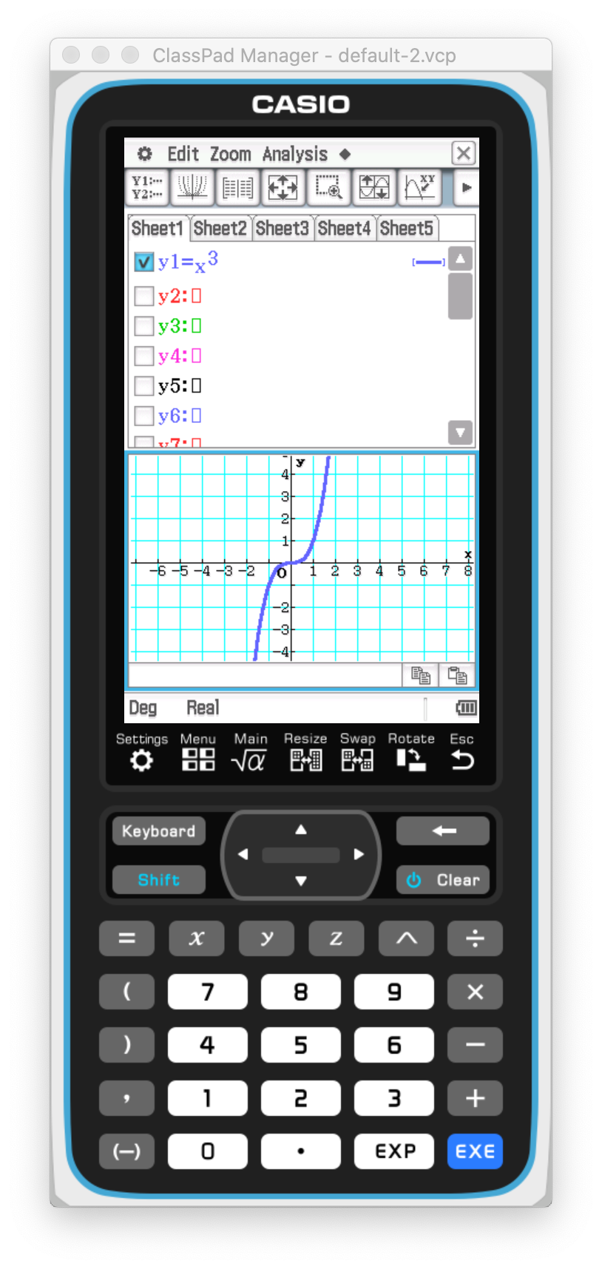
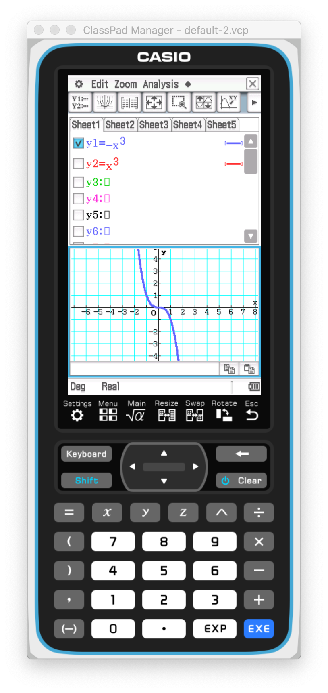
Horizontal point of inflection
Concept Development

Slide 7
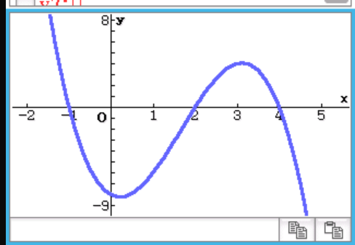
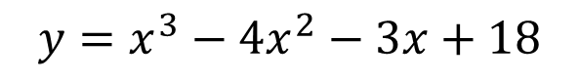
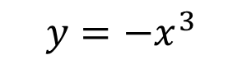
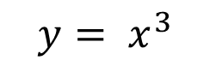
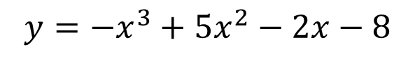
Concept Development
$$y=x^{3}−4x^{2}−3x+18$$
$$y=−x^{3}+5x^{2}−2x−8$$
$$y= x^{3}$$
$$y=−x^{3}$$
Maximum turning point
Minimum turning point
Point of inflection

Slide 8
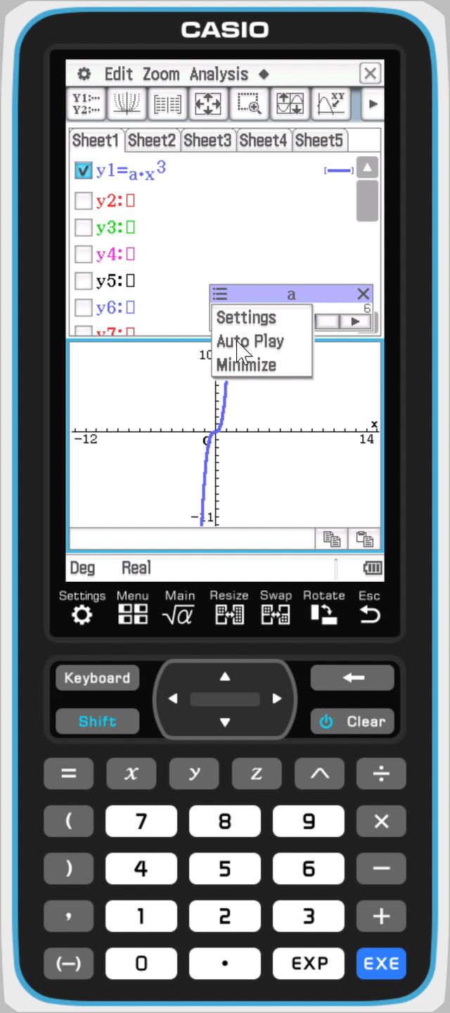
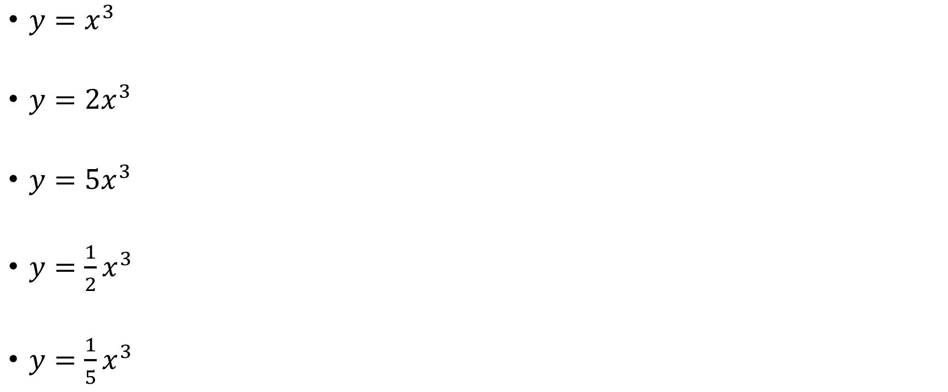
Use your Classpad to plot
Concept Development
$y=x^{3}$
$y={2x}^{3}$
$y={5x}^{3}$
$y={\frac{1}{2}x}^{3}$
$y={\frac{1}{5}x}^{3}$

Slide 9
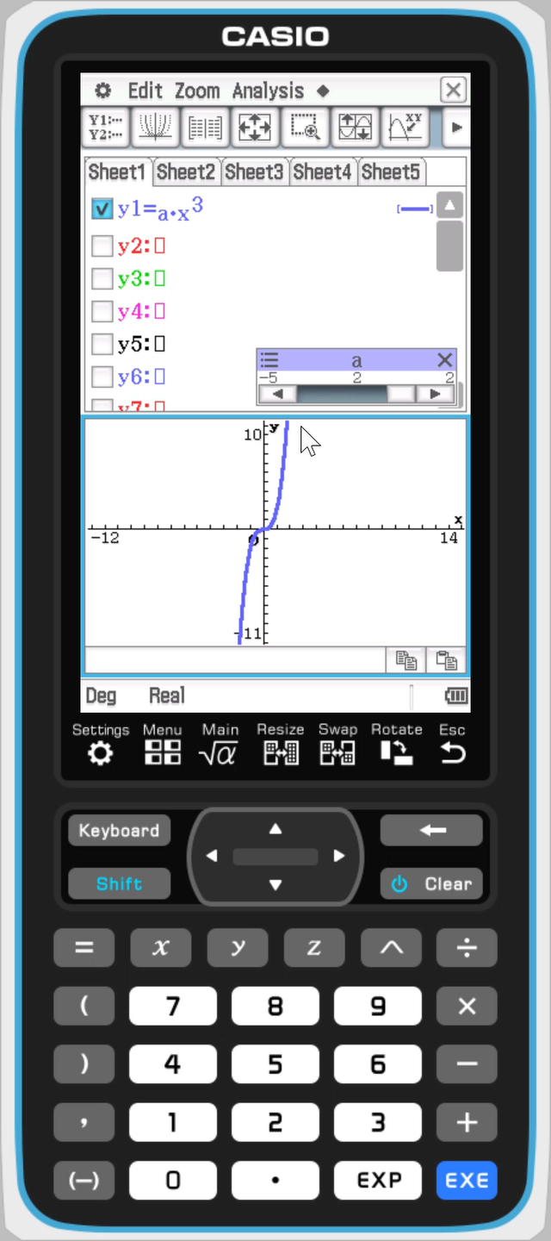
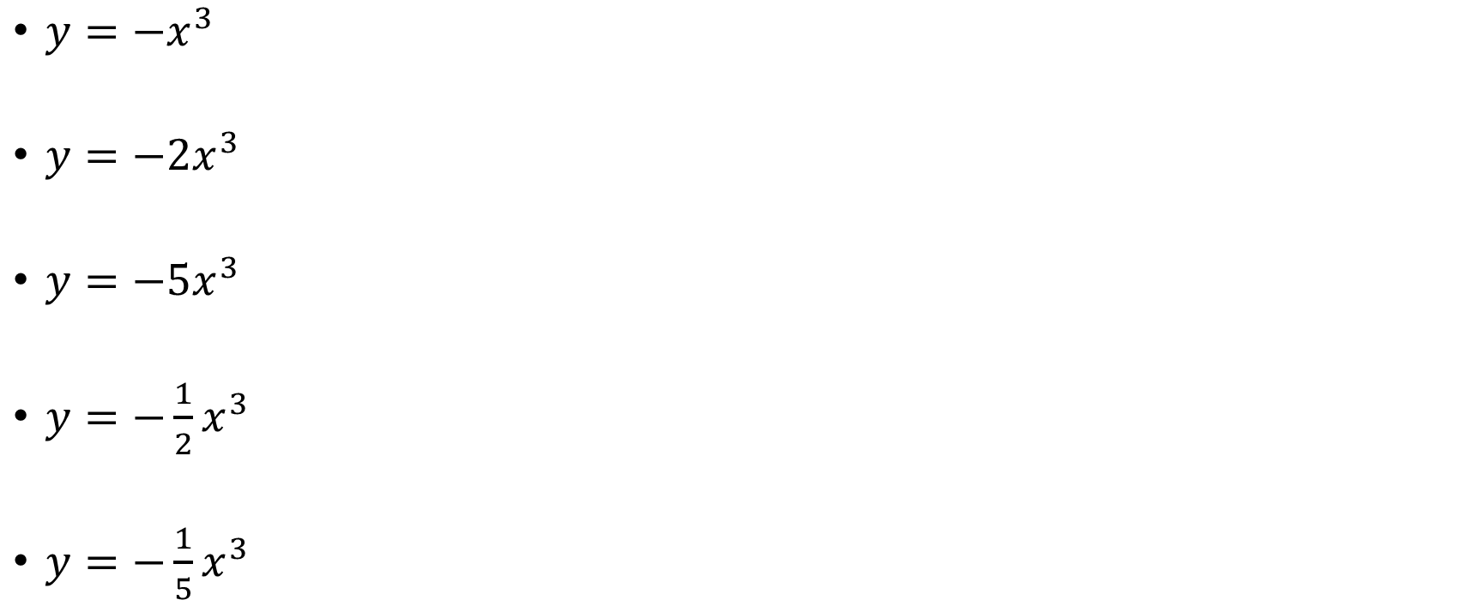
Use your Classpad to plot
Concept Development
$y={−x}^{3}$
$y={−2x}^{3}$
$y={−5x}^{3}$
$y={−\frac{1}{2}x}^{3}$
$y=−{\frac{1}{5}x}^{3}$

Slide 10
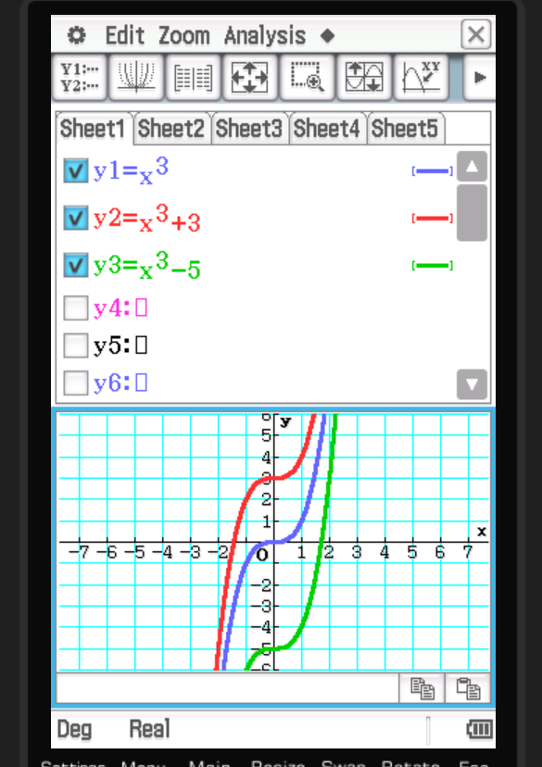
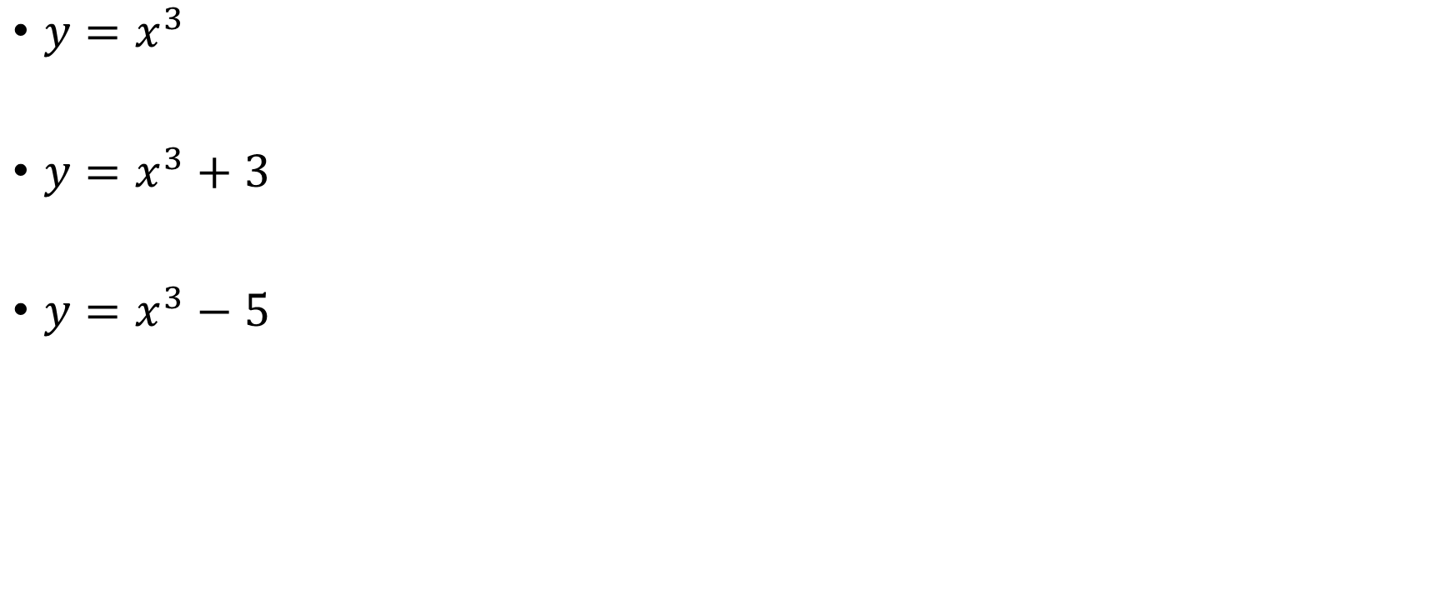
Use your Classpad to plot
Concept Development
$y=x^{3}$
$y=x^{3}+3$
$y=x^{3}−5$

Slide 11
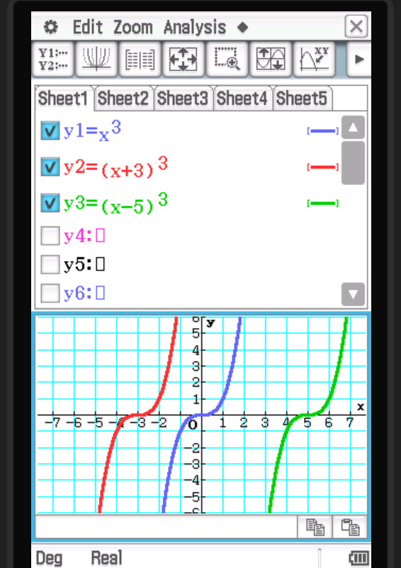
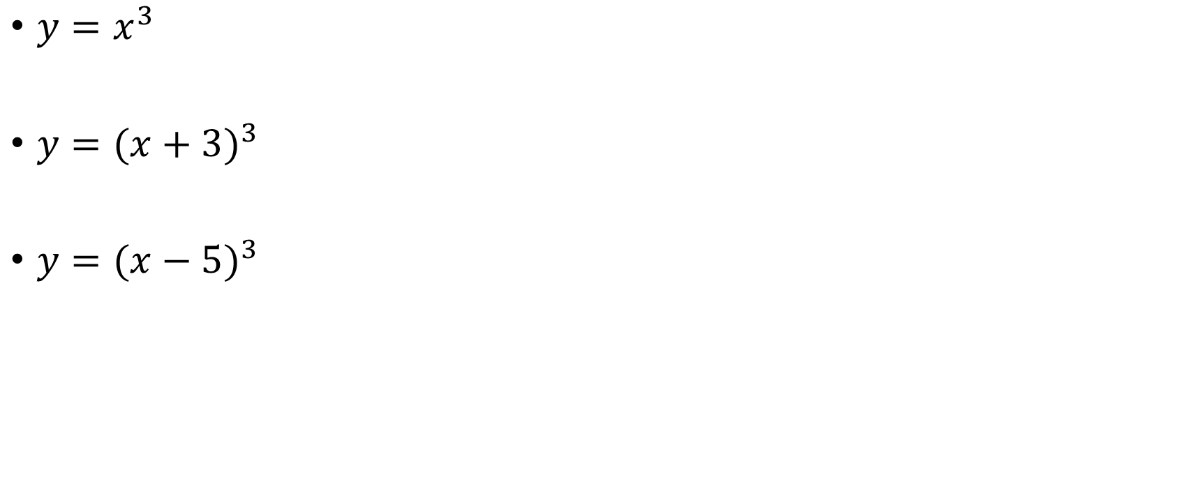
Use your Classpad to plot
Concept Development
$y=x^{3}$
$y={(x+3)}^{3}$
$y={(x−5)}^{3}$

Slide 12
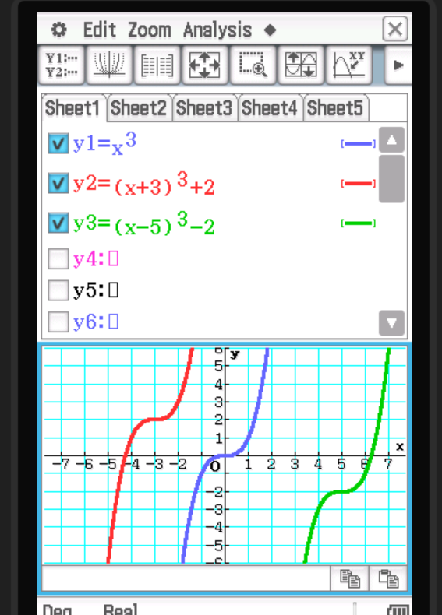
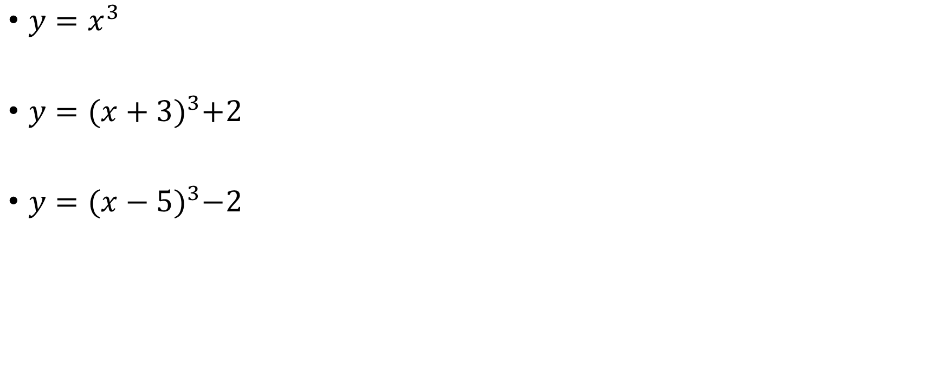
Use your Classpad to plot
Concept Development
$y=x^{3}$
$y={(x+3)}^{3}+2$
$y={(x−5)}^{3}−2$

Slide 13

Cubic function: $y=a{\left(x−h\right)}^{3}+k$ The point of inflection is $(h,k)$
Concept Development

Slide 14
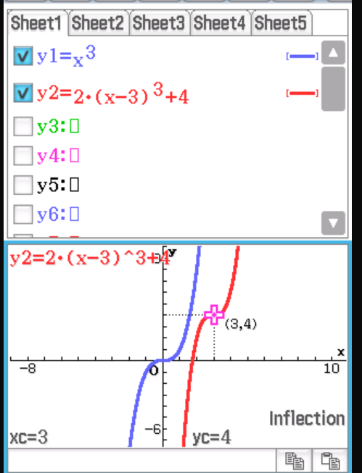
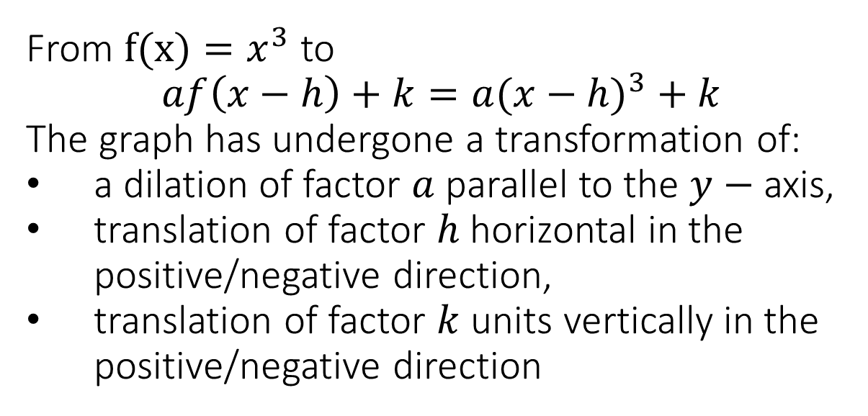
Concept Development
From $f(x)=x^{3}$ to
$$af\left(x−h\right)+k={a(x−h)}^{3}+k$$
The graph has undergone a transformation of:
a dilation of factor $a$ parallel to the $y−$ axis,
translation of factor $h$ horizontal in the positive/negative direction,
translation of factor $k$ units vertically in the positive/negative direction

Slide 15
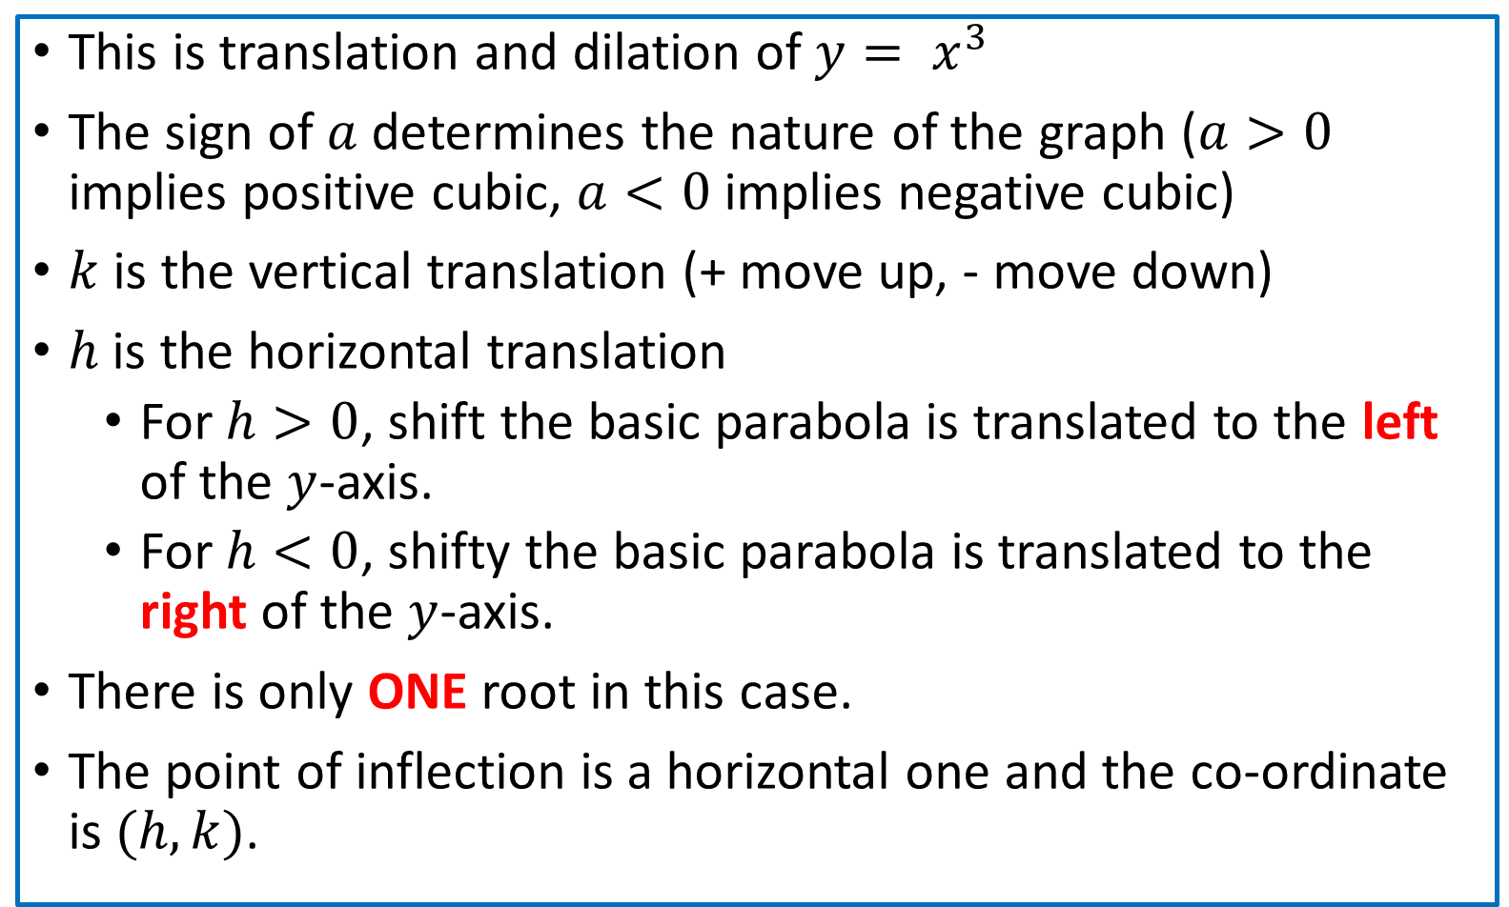

Concept Development
$$y=a{(x−h)}^{3}+k$$
This is translation and dilation of $y= x^{3}$
The sign of $a$ determines the nature of the graph ($a>0$ implies positive cubic, $a<0$ implies negative cubic)
$k$ is the vertical translation (+ move up, - move down)
$h$ is the horizontal translation
For $h>0$, shift the basic parabola is translated to the left of the $y$-axis.
For $h<0$, shifty the basic parabola is translated to the right of the $y$-axis.
There is only ONE root in this case.
The point of inflection is a horizontal one and the co-ordinate is $(h, k)$.

Slide 16

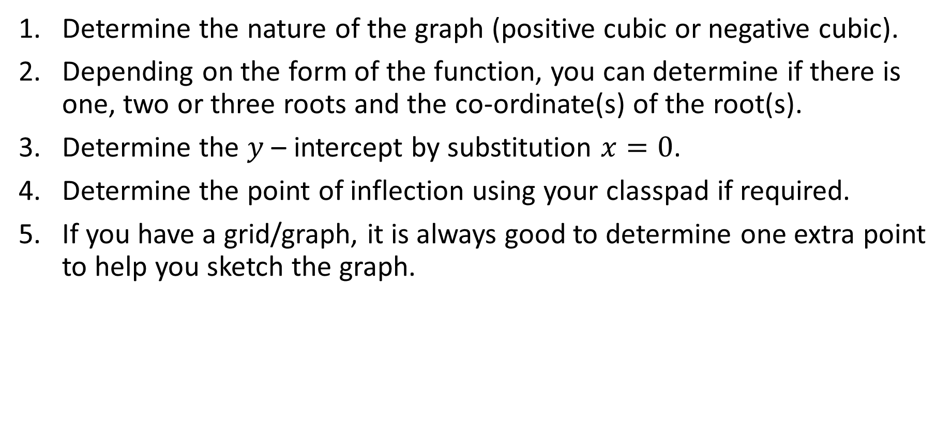

Sketching a cubic
Concept Development
Determine the nature of the graph (positive cubic or negative cubic).
Depending on the form of the function, you can determine if there is one, two or three roots and the co-ordinate(s) of the root(s).
Determine the $y$ – intercept by substitution $x=0$.
Determine the point of inflection using your classpad if required.
If you have a grid/graph, it is always good to determine one extra point to help you sketch the graph.

Slide 17
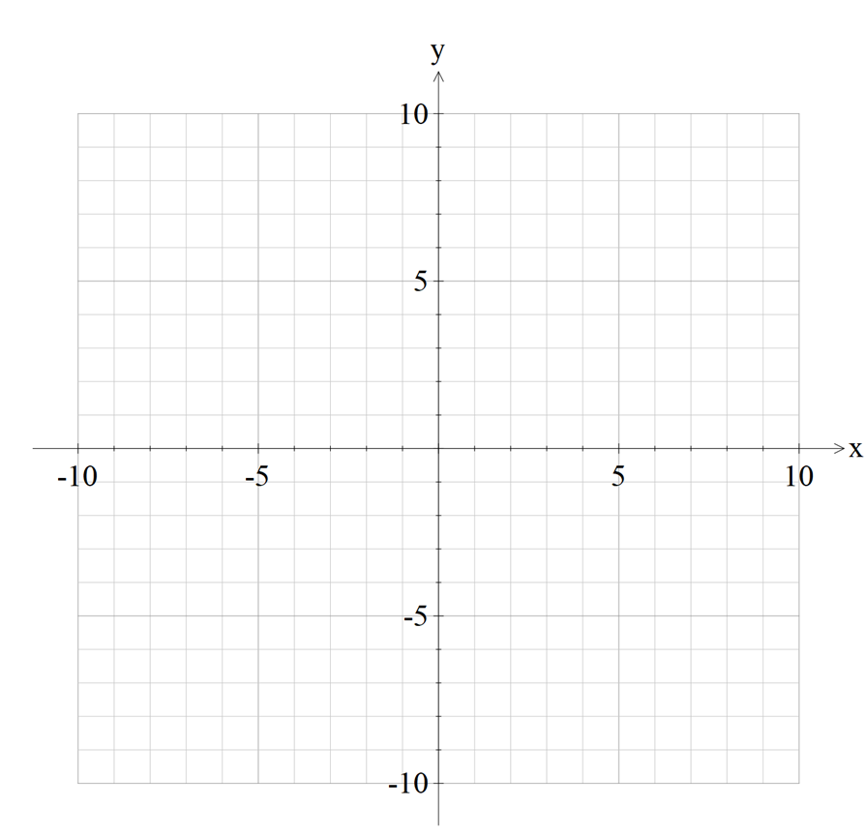
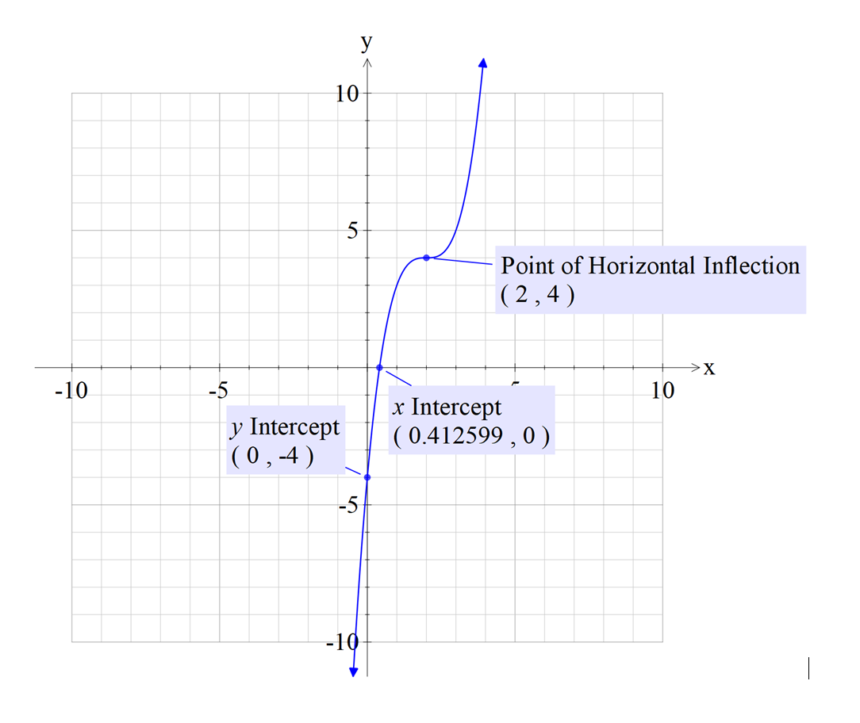



Sketch $y={\left(x−2\right)}^{3}+4$
Guided Practice
Determine the nature of the graph - Positive.
2. There is only 1 root. $$0={\left(x−2\right)}^{3}+4 \\ x=2+\sqrt[3]{−4}$$
3. Determine the $y$ – intercept by substitution $x=0$.
$$y={\left(−2\right)}^{3}+4=−3$$
4. Determine the point of inflection $(2,4)$
5. Sketch

Slide 18
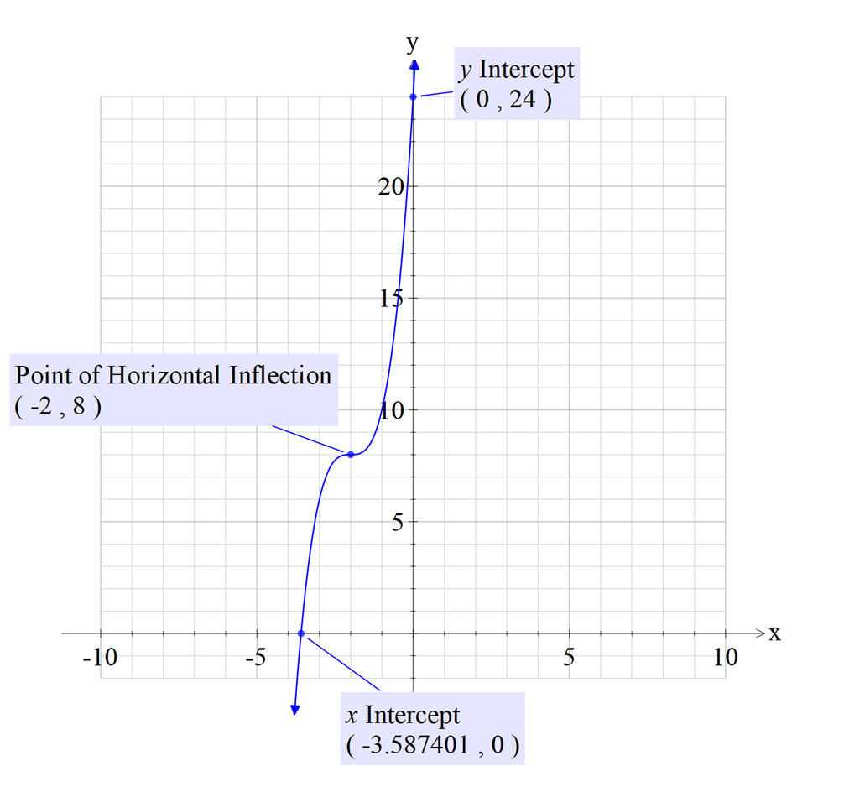
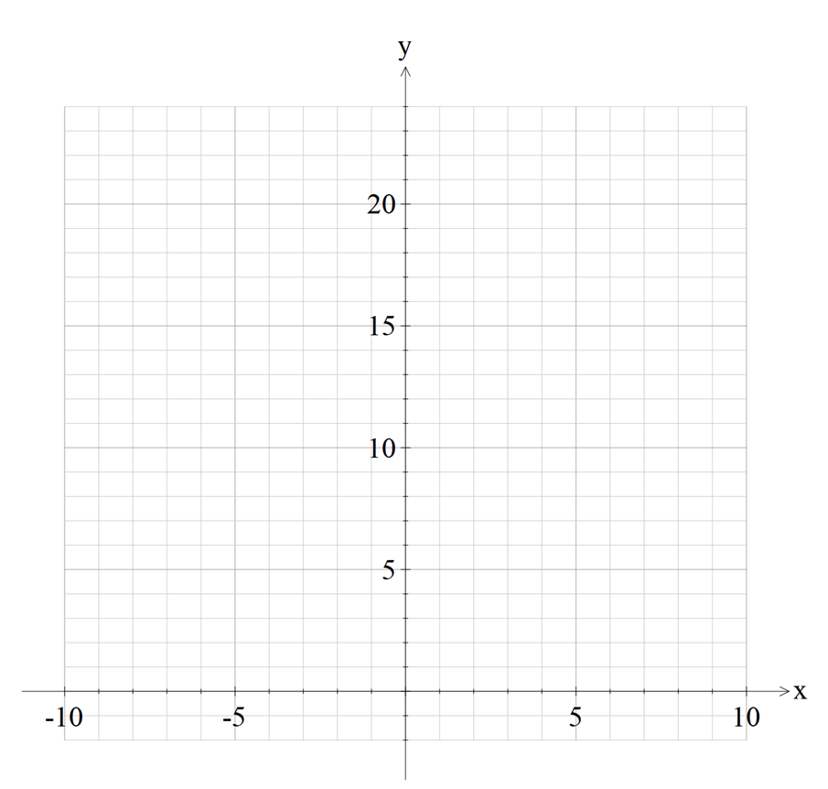



Sketch $y={2\left(x+2\right)}^{3}+8$
Guided Practice
Determine the nature of the graph - Positive.
2. There is only 1 root. $$0={2\left(x−2\right)}^{3}+8 \\ x=−2+\sqrt[3]{−4}$$
3. Determine the $y$ – intercept by substitution $x=0$.
$$y={2\left(2\right)}^{3}+8=24$$
4. Determine the point of inflection $(−2,8)$
5. Sketch

Slide 19

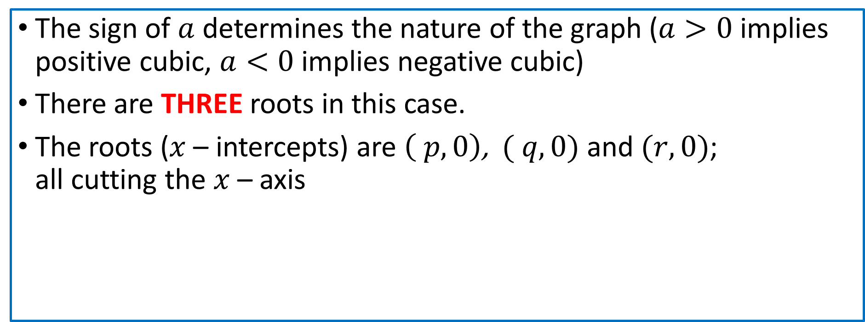






Concept Development
$$y=a(x−p) (x−q)(x−r)$$
The sign of $a$ determines the nature of the graph ($a>0$ implies positive cubic, $a<0$ implies negative cubic)
There are THREE roots in this case.
The roots ($x$ – intercepts) are $\left( p,0\right)$, $( q,0)$ and $(r,0)$; all cutting the $x$ – axis

Slide 20



Sketch $y=(x−1)(x+2)(x+1)$ (Do not find turning pt)
Guided Practice
Determine the nature of the graph - Positive.
2. There are 3 roots. $$\left(1,0\right) \left(−2,0\right) (−1,0)$$
3. Determine the $y$ – intercept by substitution $x=0$.
$$y=\left(−1\right)\left(2\right)\left(1\right)=−2$$
4. Sketch

Slide 21
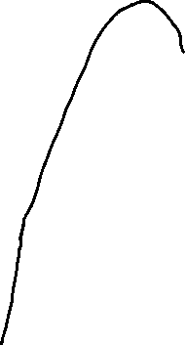

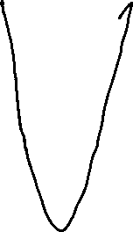


Sketch $y=(2x−1)(x−2)(x+3)$ (Do not find turning pt)
Guided Practice
Determine the nature of the graph - Positive.
2. There are 3 roots. $$\left(\frac{1}{2},0\right) \left(2,0\right) (−3,0)$$
3. Determine the $y$ – intercept by substitution $x=0$.
$$y=\left(−1\right)\left(−2\right)\left(3\right)=6$$
4. Sketch

Slide 22
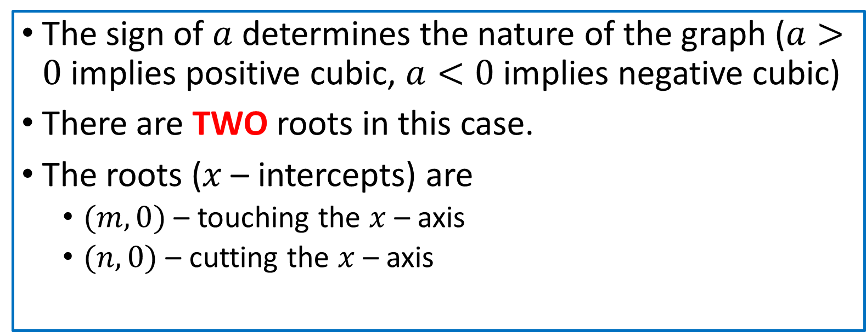



Concept Development
$$y=a{\left(x−m\right)}^{2}(x−n)$$
The sign of $a$ determines the nature of the graph ($a>0$ implies positive cubic, $a<0$ implies negative cubic)
There are TWO roots in this case.
The roots ($x$ – intercepts) are
$(m,0)$ – touching the $x$ – axis
$(n,0)$ – cutting the $x$ – axis

Slide 23



Sketch $y=x^{2}(x−1)$(Do not find turning pt)
Guided Practice
Determine the nature of the graph - Positive.
2. There are 2 roots. $$\left(0,0\right) \left(1,0\right)$$
3. Determine the $y$ – intercept by substitution $x=0$.
$$y=0$$
4. Sketch

Slide 24



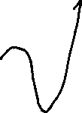


Sketch $y=\left(x−1\right){\left(x−2\right)}^{2}$(Do not find turning pt)
Guided Practice
Determine the nature of the graph - Positive.
2. There are 2 roots. $$\left(2,0\right) \left(1,0\right)$$
3. Determine the $y$ – intercept by substitution $x=0$.
$$y=−4$$
4. Sketch

Slide 25

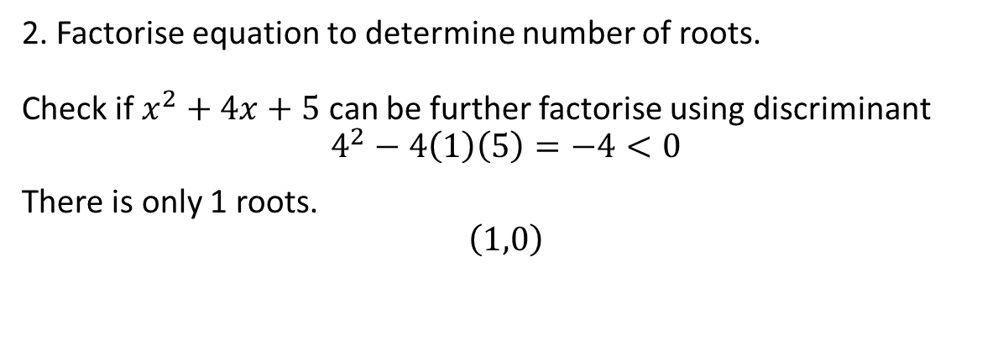
Sketch $y=−(x−1)(x^{2}+4x+5)$(Do not find turning pt)
Guided Practice
Determine the nature of the graph - Negative.
2. Factorise equation to determine number of roots. Check if $x^{2}+4x+5$ can be further factorise using discriminant
$$4^{2}−4\left(1\right)\left(5\right)=−4<0$$
There is only 1 roots.
$$\left(1,0\right)$$
3. Determine the $y$ – intercept by substitution $x=0$.
$$y=−\left(−1\right)\left(5\right)=5$$
4. Sketch

Slide 26

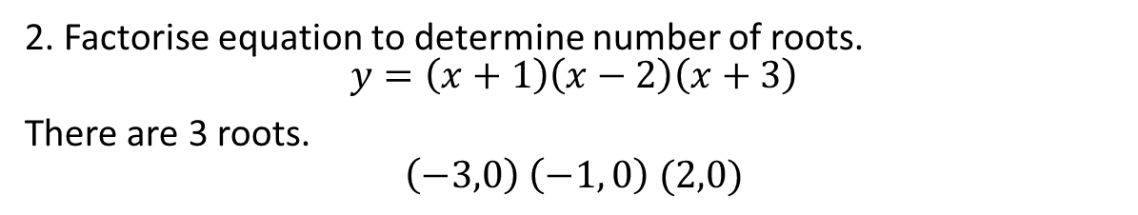

Sketch $y=x^{3}+2x^{2}−5x−6$ (Do not find turning pt)
Guided Practice
Determine the nature of the graph - Positive.
2. Factorise equation to determine number of roots. $$y=\left(x+1\right)\left(x−2\right)\left(x+3\right)$$
There are 3 roots.
$$\left(−3,0\right) \left(−1, 0\right) (2,0)$$
3. Determine the $y$ – intercept by substitution $x=0$.
$$y=\left(1\right)\left(−2\right)\left(3\right)=−6$$
4. Sketch

Slide 27

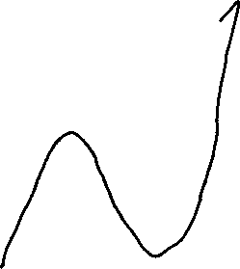
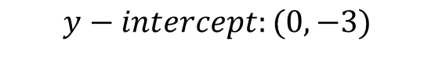

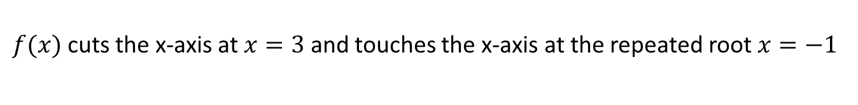

Show that the graph $f\left(x\right)=x^{3}−x^{2}−5x−3$ cuts the x-axis at one point and touches it at another. Find the values of $x$ at these points and sketch the graph.
Guided Practice
Factorise equation to determine number of roots. $$f(x)=\left(x−3\right)\left(x^{2}+2x+1\right) \\ f\left(x\right)=\left(x−3\right){\left(x+1\right)}^{2}$$
$$\left(x−3\right){\left(x+1\right)}^{2}=0 \\ x=3, x=−1$$
$f(x)$ cuts the x-axis at $x=3$ and touches the x-axis at the repeated root $x=−1$
$$y−intercept:(0, −3)$$

Slide 28
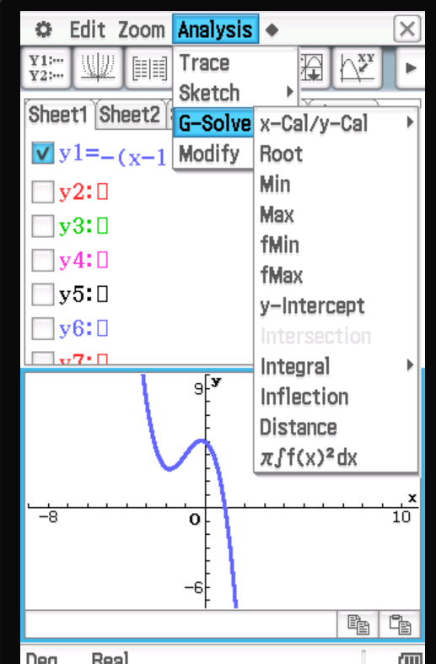
Using ClassPad $y=−(x−1)(x^{2}+4x+5)$
Guided Practice
In Graph and Table
Gsolve
Analysis > y-intercept
Analysis > Root (x-intercepts)
Analysis > Inflection (Point of inflection)
Analysis> Gsolve > Max/Min (Turning points)
Max and min turning points must be visible on screen before carrying out analysis step

Slide 29
Independent Practice
Complete Ex 7E & 7F
You do not need to draw a sign diagram

